Slide 1
KLS’S GOGTE INSTITUTE OF TECHNOLOGY Belagavi - 590008 PHASE - I Presentation on project titled “STUDY AND ANALYSIS OF friction stir welding of 3d printed polymer components”
Presented By :
NAME : RAVI JYAI USN: 2GI17MIE02
Under The Guidance Of :
Prof. Dr. Shivakumar S. Asst. Prof. Vivek Tiwary
Department of Mechanical Engineering
2017-2019

Slide 2
contents :
INTRODUCTION TO 3D PRINTING & FSW
LITERATURE REVIEW
LITERATURE GAPS
OBJECTIVES
REFERENCES

Slide 3
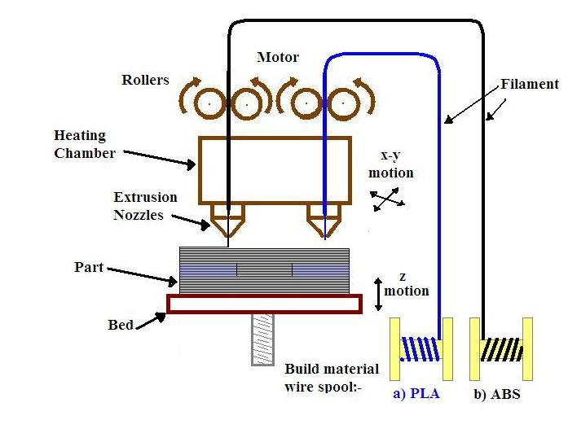
Introduction to 3D PRINTING & FSW
3D PRINTING

Slide 4
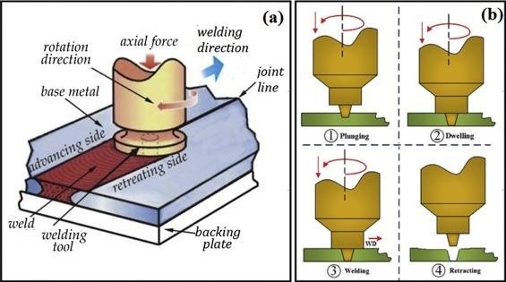
FRICTION STIR WELDING PROCESS (a) SCHEMATIC (b) VARIOUS STAGES

Slide 5
LITERATURE REVIEW
REV.NO. | AUTHOR | YEAR | TITLE | PROMINENT FINDINGS
1. | Vignesh Bose, et. al. | 2014 | Review Paper on Friction Stir Welding of various Aluminium Alloys | -Demonstrated influence of FSW on microstructure & properties of aluminium alloy
2. | Zhang l., et. Al. | 2018 | Microstructure Evolution and Properties of Friction Stir Welding Joint for 6082-T6 Aluminum Alloy | -Microstructure evolution of joint analyzed. -Found stress distribution non- uniform resulting in fracture
3. | A M Khourshid and I Sabry | 2013 | Analysis And Design Of Friction Stir Welding | -Depicts effects of rotation speed of stir at different speeds -Plastic deformation increases proportionally with stir speed
4. | A. Suresh Babu, et. al. | 2013 | An Overview of Friction Stir Welding | Shows that machine controllable parameters are having proportional relation with mechanical properties
5. | Vanita S., et. Al. | 2015 | Effect of Process Parameters of Friction Stir Welded Joint for Similar Aluminium Alloys H30 | H30 + H30 Aluminium Alloy -Depicted that tensile strength increases with tool rotation speed
6. | Santosh N. Bodake, et. al. | 2017 | Review paper on optimization of friction stir welding process parameters | Found positive relationship between axial load & tensile strength

Slide 6
12. | Bhairav Patel, et. al. | 2018 | Study on Effect of Tool Pin Profile during Friction Stir Welding of Plastics | - Analysed the effect of different tool pin profile on FSW on plastics
13. | Amir M., et. al. | 2012 | A study on the role of processing parameters in joining polyethylene sheets via heat assisted friction stir welding: Investigating microstructure, tensile and flexural properties | -Depicts the impact of process parameters on polyethylene sheets -95% increase in tensile strength with higher rotation speed of tool.
14. | H. Ahmadi, et. al. | 2012 | Influence of Pin Profile on Quality of Friction Stir Lap Welds in Carbon Fiber Reinforced Polypropylene Composite | - Use of 4 different tools is demonstrated on different composites to study weld appearance and shear strength
15. | Zoltán Kiss | 2011 | Friction Stir Welding Of Polymers | Depicts that the stationary shoulder tool enabled stronger welds with good surface quality for polymetric materials

Slide 7
20. | Anjal R. Patel, et. al. | 2016 | A Review: Dissimilar Material Joining of Metal to Polymer using Friction Stir Welding (FSW) | -Dissimilar FSWed material joint reviewed -Showed positive result but tensile strength and hardness of weld joints were lower in comparison with the base materials. - It showed mechanical bonding rather than molecular bonding of materials

Slide 8
Literature gap
The relevant findings for future prospects of the project are as listed below:
1) Most of the researches reported are focused on similar joints like Al alloy to Al alloy, Mg alloy to Mg alloy using FSW and limited is available for dissimilar metal as well as materials e.g. Metal to polymer.
2) Limited studies have been reported for effect of mechanical and micro structural properties for dissimilar polymer joining.
3) There is huge potential in the present area to analyze the effect of FSW on 3D printed objects and its successful application.

Slide 9
OBJECTIVES
To fabricate the tool for Friction Stir Welding of 3D printed polymer components.
2. Conduction of experimentation on VMC to weld the components.

Slide 10
REFERENCES
1.Vignesh Bose, D.Raguraman, D. Muruganandam, “Review Paper on Friction Stir Welding of various Aluminium Alloys”,Sivakumar, (2014)
2. Liangliang Zhang, Xijing Wang, “Microstructure Evolution and Properties of Friction Stir Welding Joint for 6082-T6 Aluminum Alloy”, (2018)
3.A M Khourshid and I Sabry, “Analysis And Design Of Friction Stir Welding”, ( 2013)
4.A. Suresh Babu, C.Devanathan, “An Overview of Friction Stir Welding”, (2013)
5.Vanita S. Thete1, Vijay L. Kadlag, “Effect of Process Parameters of Friction Stir Welded Joint for Similar Aluminium Alloys H30”, (2015)
6.“Review paper on optimization of friction stir welding process parameters”, Santosh N. Bodake, Prof. (Dr.) A. J. Gujar, (2017)
7.Thella Babu Rao, P.V. Rama Rao, V. Bala vamsi, A. Surya Chandra Babu, Pilli Venu and George Lin Prince, “Optimization Of Friction Stir Welding Parameters During Welding Dissimilar Aluminium Alloys”, (2018)

Slide 11
8.Carlos Miguel Almeida Leitão, “Influence Of Base Material Plastic Properties And Process Parameters On Friction Stir Weldability”, (2013)
9.Piyush Patel, Sachin Patel, Hiren Shah, “Design and Experimental study of Friction stir welding of AA6061-T6 Alloy for optimization of welding parameters by using Lathe Machine”, (2017)
10.Jassim Mohammed Salman Al-Murshdy, “Effect Of Tool Shape Geometry And Rotation Speed In Friction Stir Welding Of 2024-T3”, (2016)
11.Yajie Li, Fengming Qin, Cuirong Liu and Zhisheng Wu,“A Review: Effect of Friction Stir Welding on Microstructure and Mechanical Properties of Magnesium Alloys”,(2017)
12.Bhairav Patel, Vijaykumar S. Jatti, Rahul Dhabale, “Study on Effect of Tool Pin Profile during Friction Stir Welding of Plastics”, (2018)
13.Amir Mostafapour and Ehsan Azarsa, “A study on the role of processing parameters in joining polyethylene sheets via heat assisted friction stir welding: Investigating microstructure, tensile and flexural properties”, (2012)

Slide 12
14.H. Ahmadi, N.B.Mostafa Arab, F.Ashenai Ghasemi, R.Eslami Farsani, “Influence of Pin Profile on Quality of Friction Stir Lap Welds in Carbon Fiber Reinforced Polypropylene Composite”, (2012)
15.Zoltán Kiss, “Friction Stir Welding Of Polymers”- (2011)
16.Shayan Eslamia, Tiago Ramosa, Paulo J. Tavaresa, P. M. G. P. Moreira, “Effect of friction stir welding parameters with newly developed tool for lap joint of dissimilar polymers”- (2015)
17.Adeel Zafar, M. Awang and Sajjad Raza Khan, “Friction Stir Welding of Polymers: An Overview”,(2017)
18.Mustafa Kemal Bilici, Ahmet Irfan Yükler, Memduh Kurtulmuş, “Pin Profile and Shoulder Geometry Effects in Friction Stir Spot Welded Polymer Sheets”, (2016)
19.Mr. Kalpesh R. Patel, Dr. K. G. Dave, Mr. Vijay A. Radadiya, “Experimental Investigation of Friction stir Welding on Ultra High Molecular Weight Polyethylene”, (2015)
20.Anjal R. Patel, Chirag G. Dalwadi, Harikrishna G. Rana, “A Review: Dissimilar Material Joining of Metal to Polymer using Friction Stir Welding (FSW)”, (2016)

Slide 13
Thank you !

